Slide 1



DIGITAL MEDIA COMPANY(DMC) FOR ADVERTISING
Done by: Renad Albishri
01
02
03
04
05
06
07
08

Slide 2
Table of contents
01
Overview
04
Prepossessing
07
Recommendation
02
Dataset
05
EDA - graphs
08
Future work
03
06
The Question/Problem this Presentation
answering it
Conclusion
01
02
03
04
05
06
07
08

Slide 3

Overview
This presentation talks about a study for establishing an advertising company. This company will focus its work on the the most crowded subway stations in New York City
01
02
03
04
05
06
07
08

Slide 4
Dataset
MTA Dataset
Contains turnstiles usage for every station in the NYC MTA subway system: How many people entered and exited a station during a certain amount of time.
DB
Sample
Tools
01
02
03
04
05
06
07
08

Slide 5
Sample
Five Months in 2018
January
June
July
Augest
December
4,164,842 rows
11 columns
DB
Sample
Tools
01
02
03
04
05
06
07
08

Slide 6





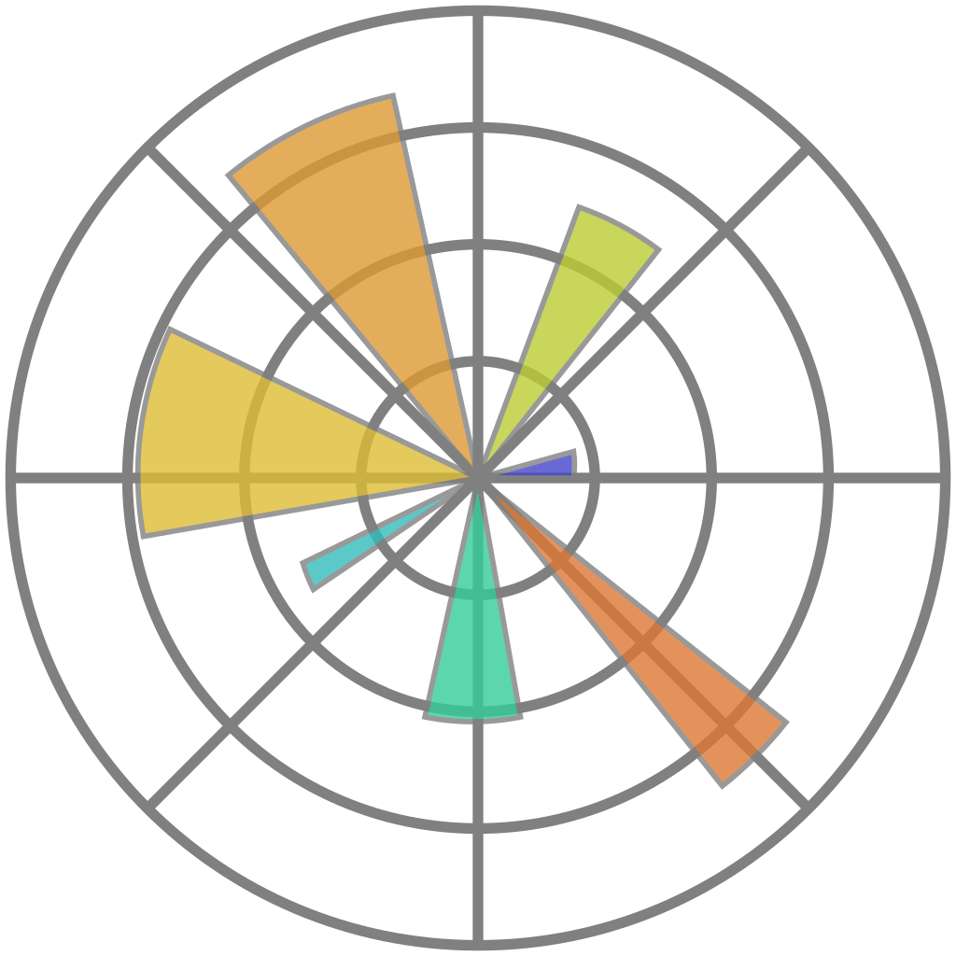

Python
SQLite
Pandas
Tools and Libraries
NumPy
SQLAlchemy
Matplotlib and seaborn
DB
Sample
Tools
01
02
03
04
05
06
07
08

Slide 7
The Question/Problem this Presentation answering it
Which is that the most crowded Stations
in New York City?
Which is the busiest month in the year?
Which is the busiest day in the week?
01
02
03
04
05
06
07
08

Slide 8
Prepossessing
01
02
Renaming
columns
Drop duplicate or unnecessary data
03
04
Handling missing values
(Drop NULL values)
SATURN
Check for outliers and drop it
05
06
Remove irregular (Recover Audit)
Adding new columns
01
02
03
04
05
06
07
08

Slide 9
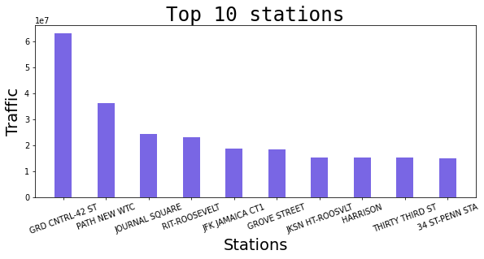
EDA – graphs
1st Graph
2nd Graph
3rd Graph
4th Graph
01
02
03
04
05
06
07
08

Slide 10
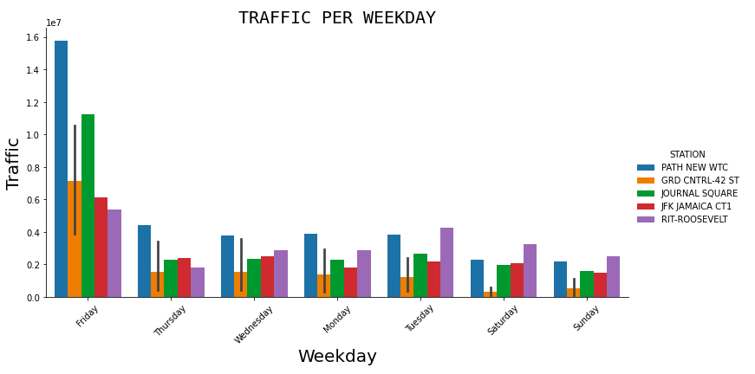
EDA – Graphs cont…
Weekday
1st Graph
2nd Graph
3rd Graph
4th Graph
01
02
03
04
05
06
07
08

Slide 11
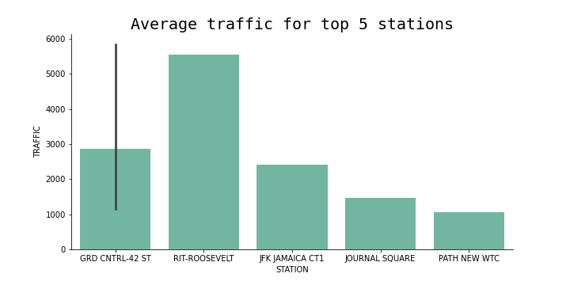
EDA – Graphs cont…
Weekday
1st Graph
2nd Graph
3rd Graph
4th Graph
01
02
03
04
05
06
07
08

Slide 12
Conclusion
We conclude from our study that:
The busiest months in the selected months
January , June
The busiest day in the week
Friday , Thursday
The most crowded stations in new York City
PATH NEW WTC
GRD CNTRL-42 ST
34 ST- HEARALD SQ
01
02
03
04
05
06
07
08

Slide 13

Recommendation
I recommend that the DMC should targeting the most crowded subway stations and the most crowded stations that we got in this study which it will be suitable for our project.
PATH NEW WTC
GRD CNTRL-42 ST
34 ST- HEARALD SQ
01
02
03
04
05
06
07
08

Slide 14
Future Work
For the future we are looking to use more data (more and more years) to analyze the data and use more technologies.
DMC is planning to operate in another city like Paris and London so we will analyze the subway stations in those cities.
01
02
03
04
05
06
07
08

Slide 15
THANKS!
Do you have any questions?
01
02
03
04
05
06
07
08

